Slide 1
EMC-GUI
Client Application for Flight Simulation Based Research
Kate McManus John Gallagher
Computer Science Project Advisor

Slide 2
Background
Disorientation Research Device: A flight simulator used by the Naval Medical Research Unit in Dayton for aeromedical research.
Authentic flight replication with 6 degrees of freedom.
Data of the device’s state collected during runtime.
Also called Motion Control (MC).
More information: https://www.etcaircrewtraining.com/kraken-spatial-disorientation-trainer.html
External Motion Control (EMC) Server: Application which sends commands to and receives data from the MC.
Sends motion type settings, server data, and stop command to the MC.
Receives run command, runtime data, and stop command from the MC.
Researchers use EMC to communicate with the MC during all flight simulation runs.

Slide 3
The Problem
Interacting with the EMC server is extremely inconvenient!
Only runs on Linux OS.
User must use SSH terminal to remotely interact with server
Command line only. There is no GUI.
What if server interaction was more convenient, and could be done on any operating system?

Slide 4
Goals
Client side:
Send and receive UDP packets containing data and commands.
Read and recognize a run setup command.
User can select motion type settings and send them to server.
Parse data sent from server and accurately label and display on screen.
User can press a button to send a stop command.
Server side:
After receiving run setup command from MC, notify the client.
Receive settings from client and assign to the correct values. Send to MC.
Send EMC and MC data to client.
Listen for a stop command from client. Stop data collection.

Slide 5
Intellectual Merits
Making this project successful required learning how to design new software around the structure of existing software in a way where both will work together without negatively impacting the function of the old software.
This assignment gave me the opportunity to learn more about the software that I will be using after I graduate.
The methods used in developing the client will be important for future projects. May replace old software.

Slide 6
Broader Impacts
Improves data collection for flight simulation research.
Interaction with Motion Control becomes more convenient for researchers.
The purpose of research is to study aeromedical and environmental health threats faced by Navy pilots.
The EMC-GUI client is designed using Qt C++, which is cross platform. NAMRU-Dayton plans to move to this method in the future. Client code can be used as a framework for future projects.

Slide 7
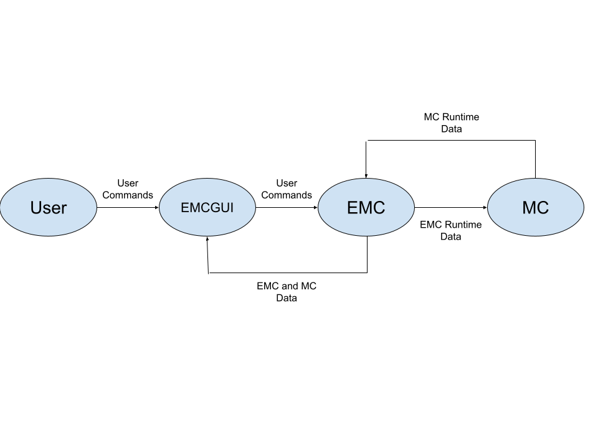
Design Specifications - Overview

Slide 8
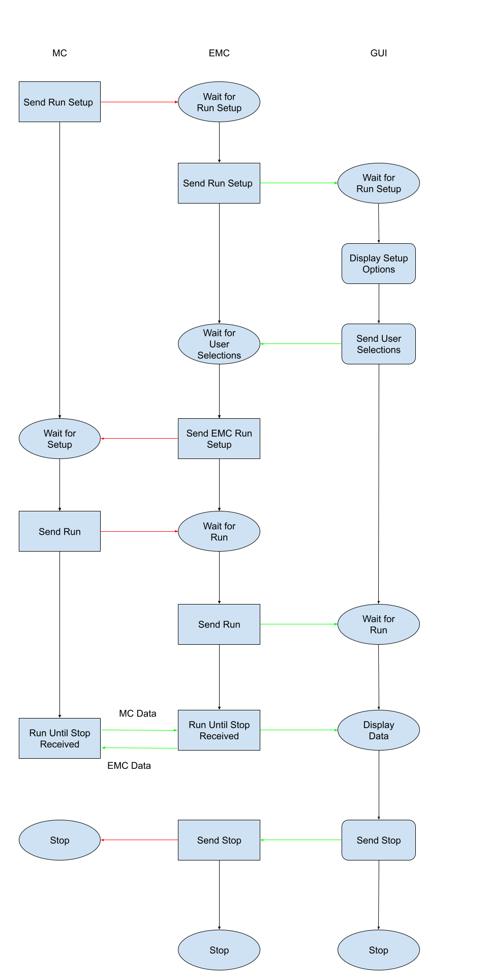
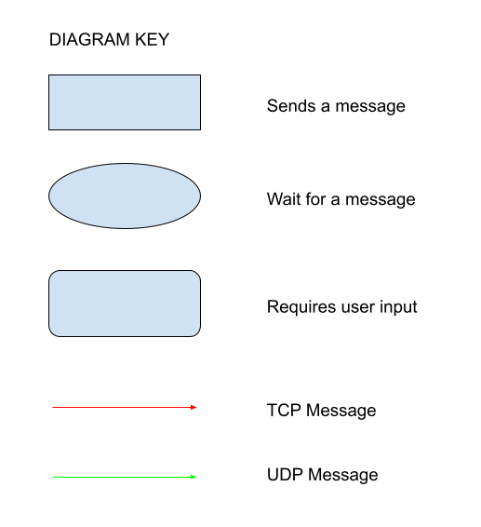
Design Specifications
MC sends a run setup command to EMC.
EMC passes message to Client.
User inputs motion type selections.
Client sends selections to EMC.
EMC passes selections to MC.
MC begins a run, sends notification to EMC.
EMC passes run notifications to Client.
MC and EMC pass runtime data between each other.
EMC sends both sets of data to Client.
Client displays data to user.
User can stop data collection at any time.
Client sends stop command to EMC.
EMC passes stop command to MC.
Events must happen in this order!

Slide 9

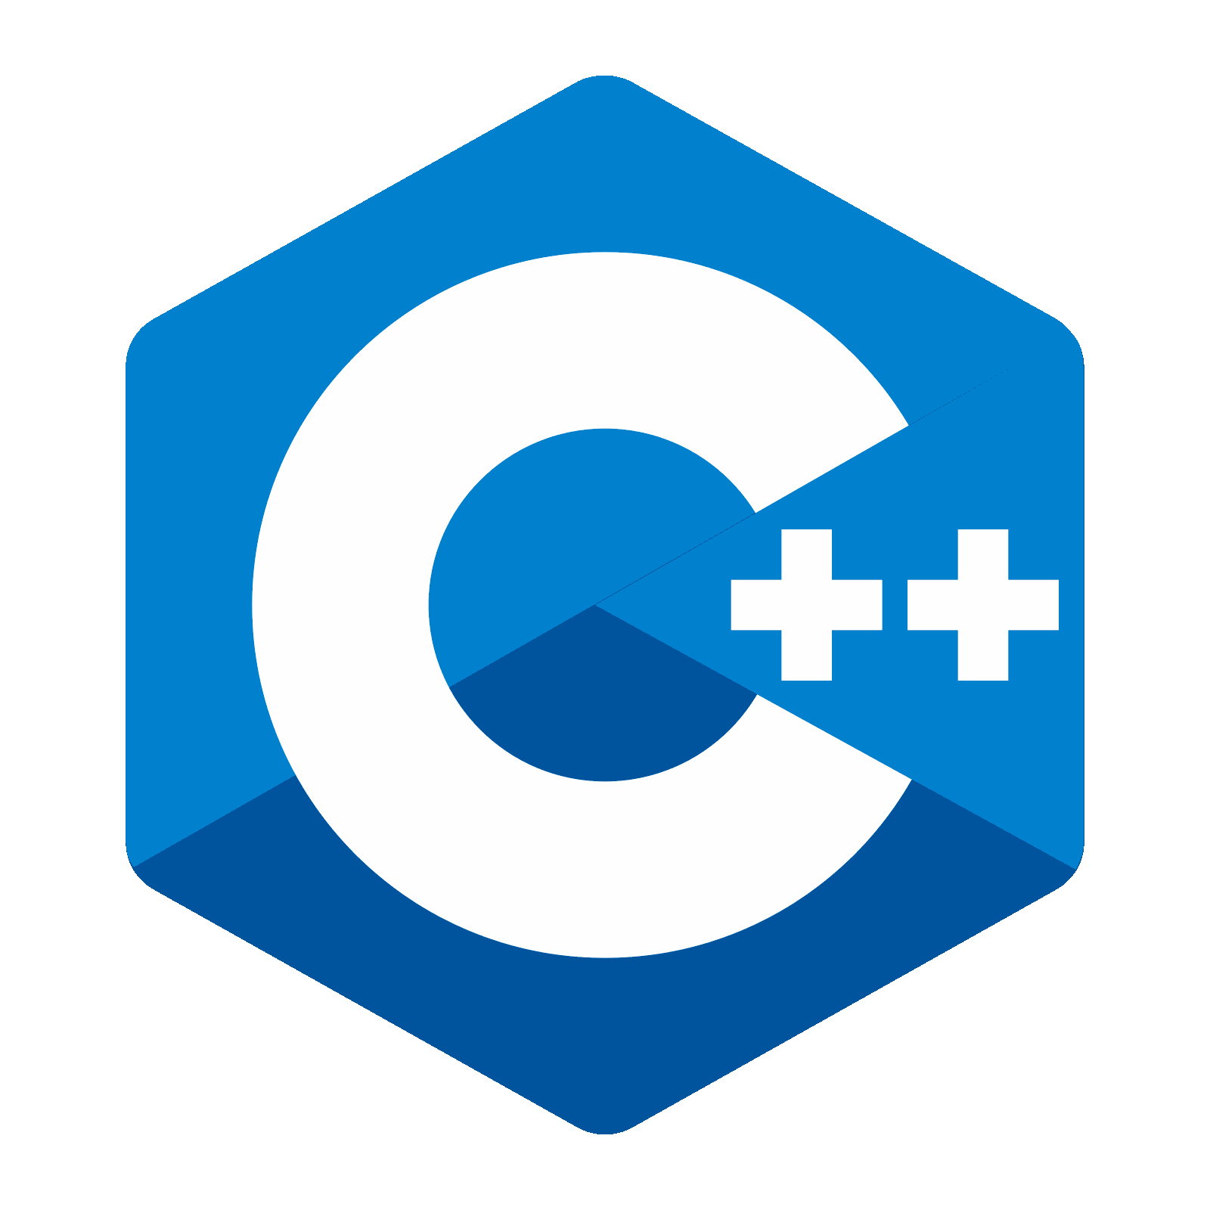
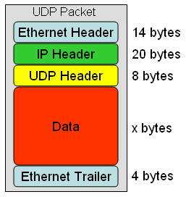

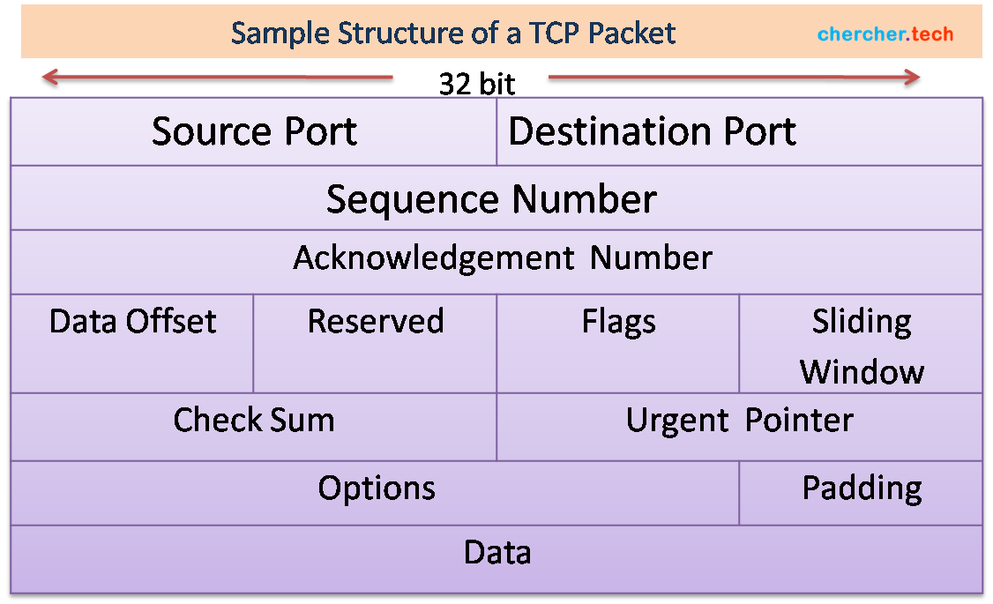
Technologies
Qt Creator C++ User Datagram Protocol
Linux Transmission Control Protocol
Client
Client & Server
Client & Server
Server
Server

Slide 10
Milestones
Milestone # | Description | Date Completed | Goal Met?
1 | A Linux server is set up on a virtual machine. | 11/3/21 | Scrapped – Code run on separate laptop.
2 | The EMC Server code can be run on VM. | 11/17/21 | Scrapped – Code run on separate laptop.
3 | Write a program that emulates the MC. | Began 11/3/21 | Scrapped – never completed.
4 | Client receives UDP messages. | 10/4/21 | Yes.
5 | The EMC Server can communicate with the client app. | 2/23/22 – Receive packets 3/1/22 – Send run command. 3/24/22 – Send simulated data | Yes
Milestone # | Description | Date Completed | Goal Met?
6 | Client labels and displays data. | 10/8/21 (minor fix 3/23/22) | Yes
7 | The user can select settings. | 10/16/21 | Yes
8 | The application can send UDP packets to the server. | 1/4/22 | Yes
9 | The user can stop and resume data collection. | Not Complete | No
10 | Full application successfully tested on site. | Not Complete | No – On site testing with MC connection not complete.
11 | Receive feedback. | 3/25/22 | Yes

Slide 11
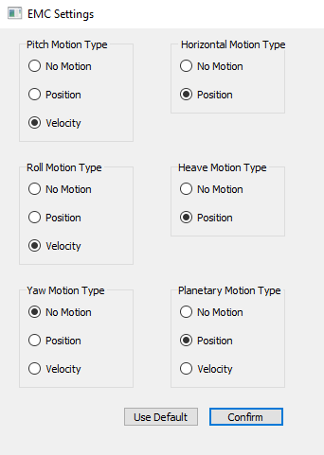
Results
Client side:
Can send and receive UDP packets containing data and commands.
Can read and recognize a run setup command.
User can select motion type settings and send them to server.
Client can parse data sent from server and accurately label and display on screen.
Server side:
Server can send a run setup command to client.
Server can receive settings from client and assign to the correct values.
Server can send EMC data to client.
Client-side UI for settings selection.

Slide 12
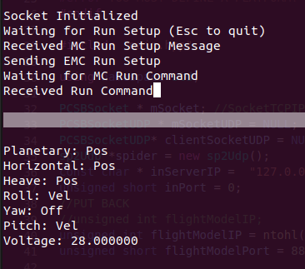
Results
Goals not met:
Client can send a stop command, but server cannot listen for it while data is being sent.
Server cannot send MC data to client.
Communication between EMC and Client has been tested, but integration with the MC was never tested due to time constraints.
Connection with MC cannot be tested from home.
No TCP connection with MC.
Server tested in “demo mode”.
Feedback:
Employer is happy with project progress.
Next step is integration with the MC.
Project progress will continue after graduation.
Project can be used as a framework for other code.
Server-side output. Includes user selected settings.

Slide 13
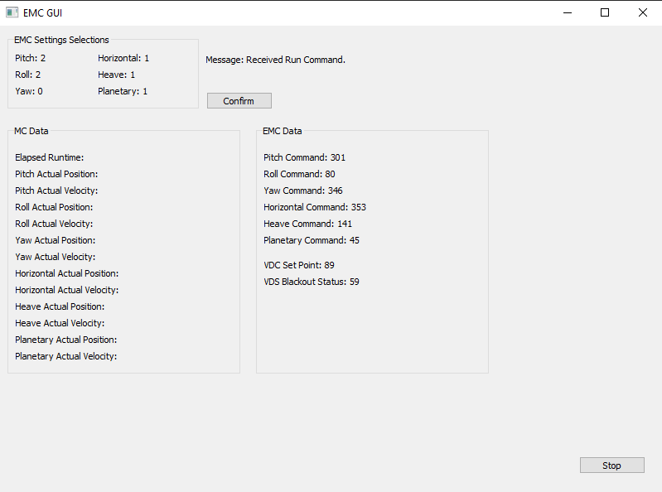
Results
Next steps:
By demo, I will attempt to have the server receive stop commands from the client and stop data collection.
After graduation, I will add TCP message passing between client and server for sending single messages.
Server will be taken out of “demo mode”, will connect to MC.
Client will be able to display MC data alongside EMC data.
Client-side data display window during runtime.

Slide 14
Challenges
The server sends UDP messages using a custom framework called PCSBSocket. The client uses Qt’s QtUDPSocket library.
Sending a data struct is done differently by each. PCSBSocket cannot recognize structs sent by QtUDP.
Solution: PCSBSocket can recognize strings sent by QtUDP. Data is passed as a string and parsed using sscanf() function.
Due to time constraints and the MC being used for other projects, the project could never be connected to the MC for testing.
Server requires a TCP connection, listens for TCP packets from MC. It will halt if a packet is not received.
Solution: I created a “test client” flag that when set to true, will put the server in demo mode. Demo mode ignores TCP connection and sends simulated data.
The client must be built around the server. Any major modifications to the server code could hurt functionality.
Solution: Demo mode. No existing code was removed from the server.

